Slide 1
CEE 264 Final Project
Behavior Modeling on Airbnb Housing Options
Yingjia Feng Miguel F. Montes
Chenhui Hao Upadhi Vijay
Yanis Pradeau Yi Shen

Slide 2
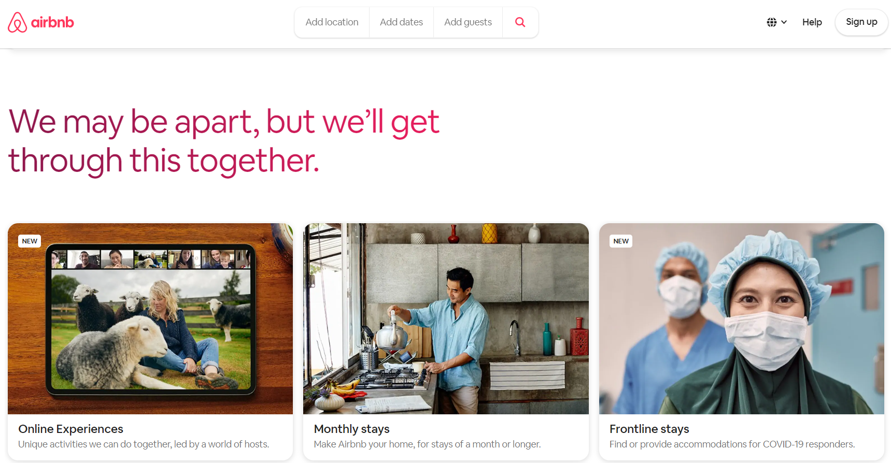
Contents
Introduction & Motivation
Methodology
Data Collection
Modeling
Conclusion and Recommendations

Slide 3
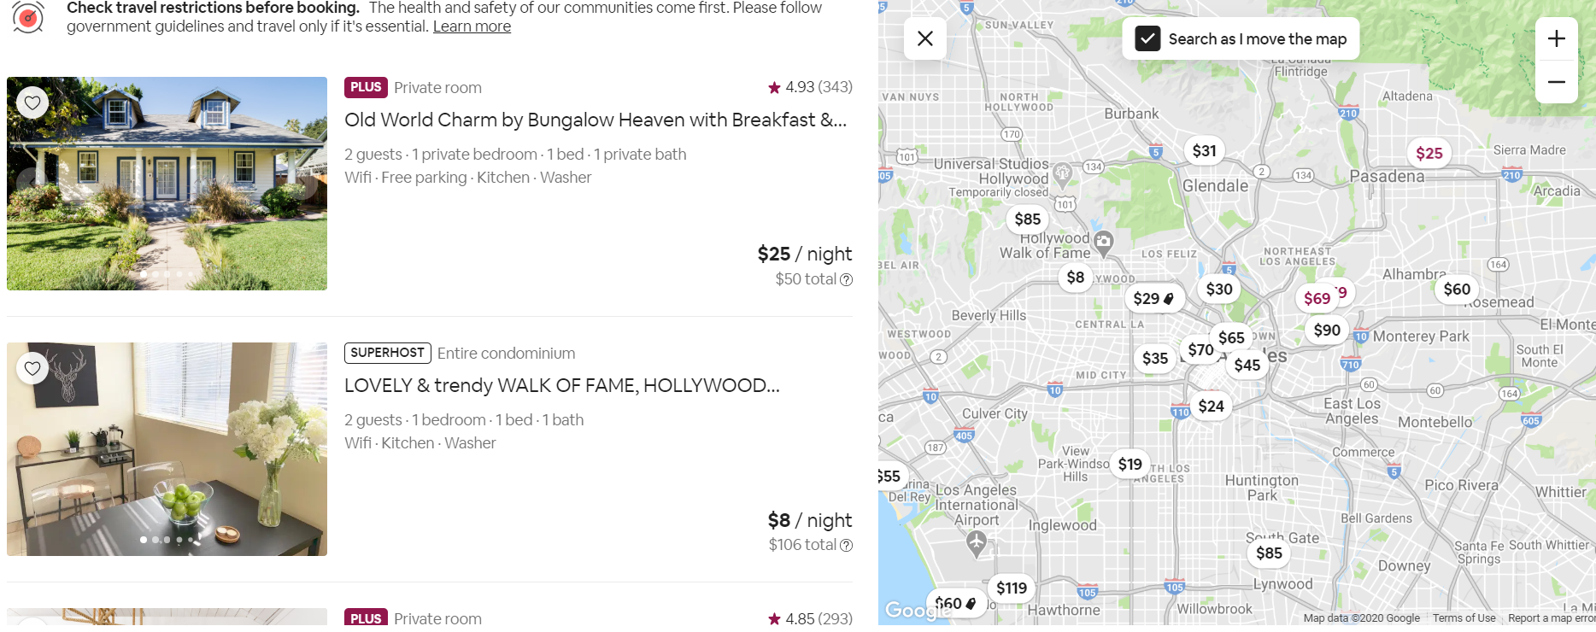
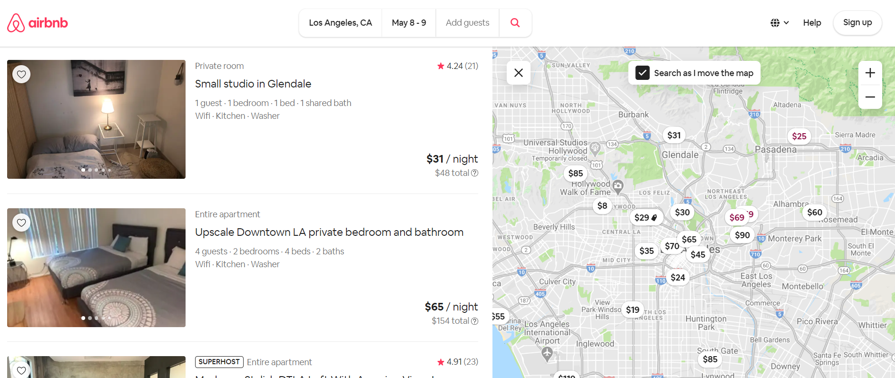
Introduction and Motivation
Better understand the customers’ choices, and familiar with the modeling process.
Aim to help the Airbnb hosts tailor the listing information.
Notes:
加个好看的图

Slide 4
Methodology
Open Source Data Cleaning
Choice Set Selection and Survey Design
Survey Data Collection
Modeling & Result Analysis

Slide 5
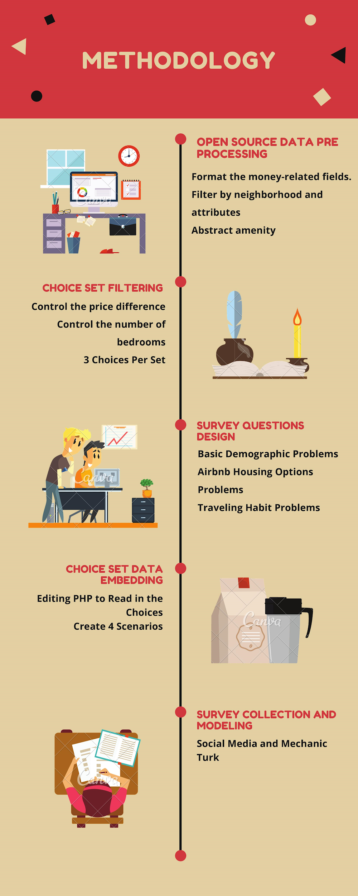
“Inside Airbnb” Data
Open source dataset consisted of 38k listings and 106 features
12 attributes from the original 106 were chosen
Host - superhost, response time
Property - neighborhood, beds, bedrooms, bathrooms, housing type, TV, pool, review
Booking policy - price, cancellation policy, deposit
LA was used as a proxy city for preparing attribute values in the choice sets
http://insideairbnb.com/
Notes:
Change the neighborhood names into descriptive words.

Slide 6
Survey Design
4 trip scenarios
Create choice sets from “Inside Airbnb” data based on
Similar range of prices
Most representative types of listings: most common property types and popular neighborhoods
Listing capacity suited to trip scenario
Purpose | Number of guests | Number of nights
Vacation/Leisure | 4 | 3
Vacation/Leisure | 2 | 6
Business | 1 | 2
Business | 2 | 1
Notes:
哪些relevant attributes介绍一下 (在上一页)
提取amentities的时候的标准， 为什么没有留下WiFi和pool
隐去neiborhood信息，换成形容词
Choice set如何确定（价格不要相差太远，bedroom number如何给每个scenario确定）

Slide 7
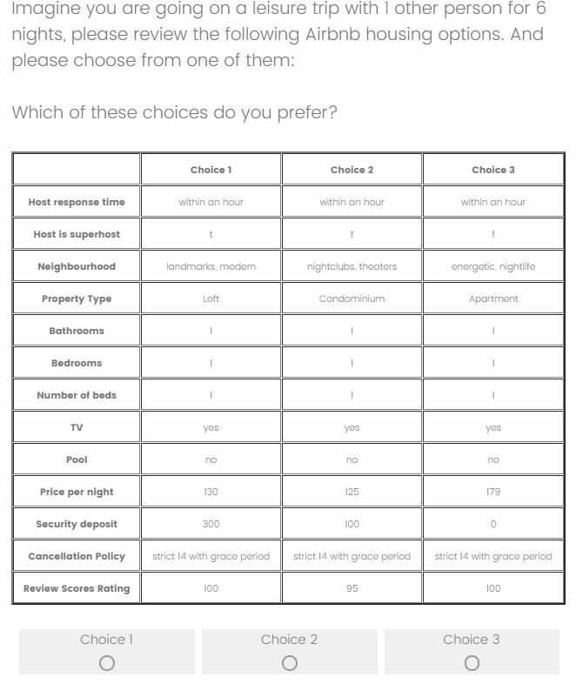
Survey Design
Demographic Questions
Age / Gender
Income
Employment Status
Travel Behavior Questions
Used Airbnb before
Travel Frequency
Travel Experience Preferences
Airbnb Housing Choices Questions (4 scenarios)
3 randomly selected alternatives

Slide 8
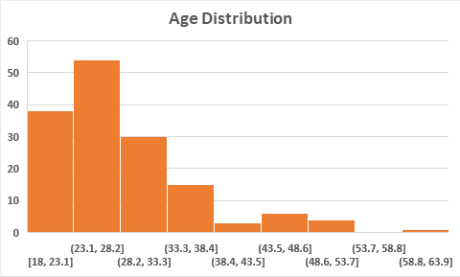
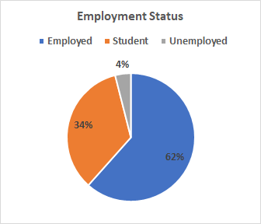
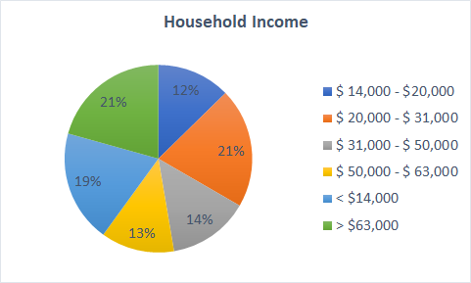
Data Collection
151 valid records
Social Media and Amazon Mechanical Turk

Slide 9
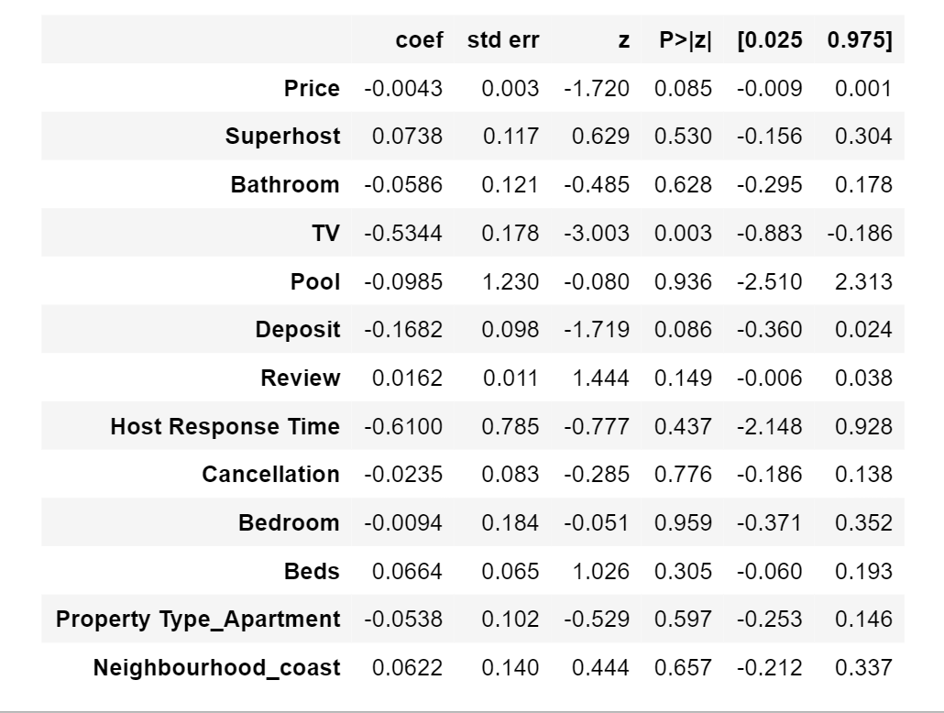
Model 1
What do Airbnb attributes say?

Slide 10
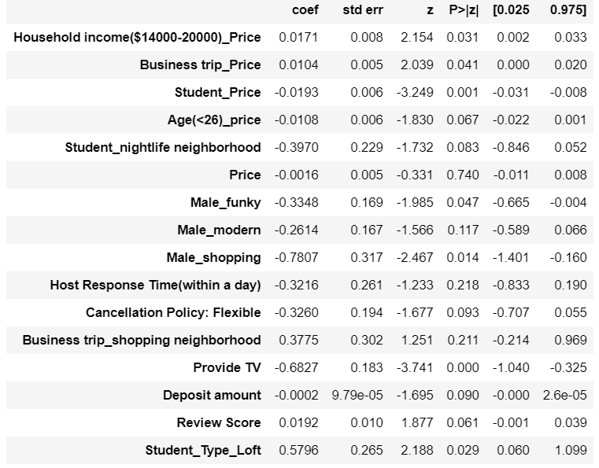
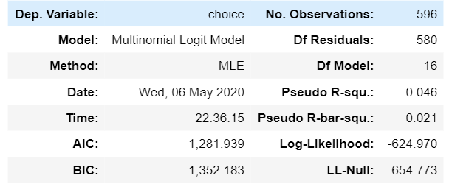
Final Model
How do individual characteristics influence the choices?

Slide 11
Conclusion and Recommendations
Price is one of the most relevant attributes
Students and individuals under 26 years-old are more sensitive
Price has a positive impact in business trips
Review rating and cancellation policy are also important factors
Preference of neighborhood varies with gender
Shopping neighborhood appears to be the most popular
Notes:
Price is one of the most relevant attributes but its effect varies across individuals
Preference of neighborhood varies with gender, trip scenario

Slide 12
Limitations and Future Work
Limitations
Limited number of survey responses (151 in total)
Strong assumptions during preparation of choice sets
Correlation between features
Biases in the survey data (88% of surveyed population had used Airbnb before)
Future Work
Use different models to capture heterogeneity e.g. latent class models
Take text based reviews into consideration (sentiment analysis)
Implement rigorous survey and experimental design
Notes:
Limited number of responses, hences diffucult to analyise overall behavior.
Selection of attributes in the choice set was based on presumptions that they are more critical in determining an Airbnb and features displayed on Airbnb website at first , PCA could have been adopted to identify what features are more curcail
There was correlation in the model parameters which couldn’t be eliminated easily. Parameter for deposit is affected by price, and type of neighbourhood
Behavior seems to vary person to person - logit mixture model can be a possible option

Slide 13
Reference
Satama, S. (2014) “Consumer adoption of access-based consumption services-Case AirBnB”
Verma, R. “Customer choice modeling in hospitality service: A review of past research and discussion of some new applications”
Verma, R., & Thompson, G. M. (1997) “Discrete choice analysis in hospitality management research”
Fradkin, A. A “Simulation Approach to Designing Digital Matching Platforms”
Kevin Kam Fung So, Haemoon Oh, Somang Min “Motivations and constraints of Airbnb consumers: Findings from a mixed-methods approach, Tourism Management”, Volume 67, 2018, Pages 224-236, ISSN 0261-5177
Dr. Kevin K. F. Wong & Lam Chi-Yung (2002) “Predicting Hotel Choice Decisions and Segmenting Hotel Consumers: A Comparative Assessment of a Recent Consumer Based Approach”, Journal of Travel & Tourism Marketing
Vivek Kumar Singh “The Effect of Image Choice on Airbnb Reservations: A Combination of Deep Learning and Econometric Analysis”

Slide 14
Thanks for your Attention!

Slide 15
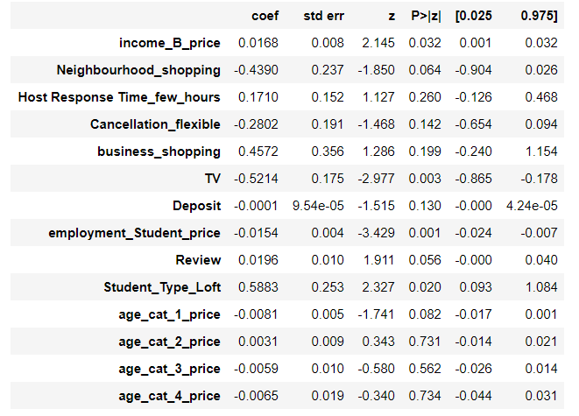
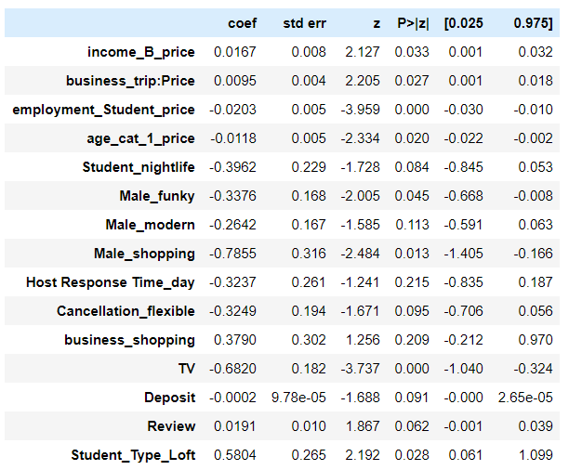
Insight into the models: Fun Facts
Which age group has the different reaction when speaking of price sensitivity?
Some interesting interactions for student / gender and neighborhood type:

